Slide 1
Trees
CME4422

Slide 2
Outline
Definitions
  Forest, Tree, Spanning Tree
  Cycle Rank, Cutset Rank
  Fundamental Set of Cycles
Graph Enumeration Problem
  Cayley’s Theorem
  Matrix-Tree Theorem
Examples

Slide 3

Forest
A forest ia a graph with no cycles.
A tree is a connected forest.

Slide 4
Properties of Trees
A tree T contains no cycles, has n vertices, m=n-1 edges
T is a connected graph
Every edge in T is a bridge
Any two vertices on T are connected by exactly one unique path

Slide 5
If F is a forest with n vertices and k components, then we have n+1-k edges.
Ex. k=4, n=26, |E|=27-4=23

Slide 6
Spanning Tree
A spanning tree T connects all vertices of a graph G without any cycles.
To find a spanning tree for any connected graph G, examine cycles in the graph and remove edges which are not briges.
Removal of any edge in T divides the graph into two disjoint sets.

Slide 7
Example
This spanning tree for G is NOT unique!
There are other spanning trees for G.
v
w
x
y
z
v
w
<-For example
x
y
z

Slide 8
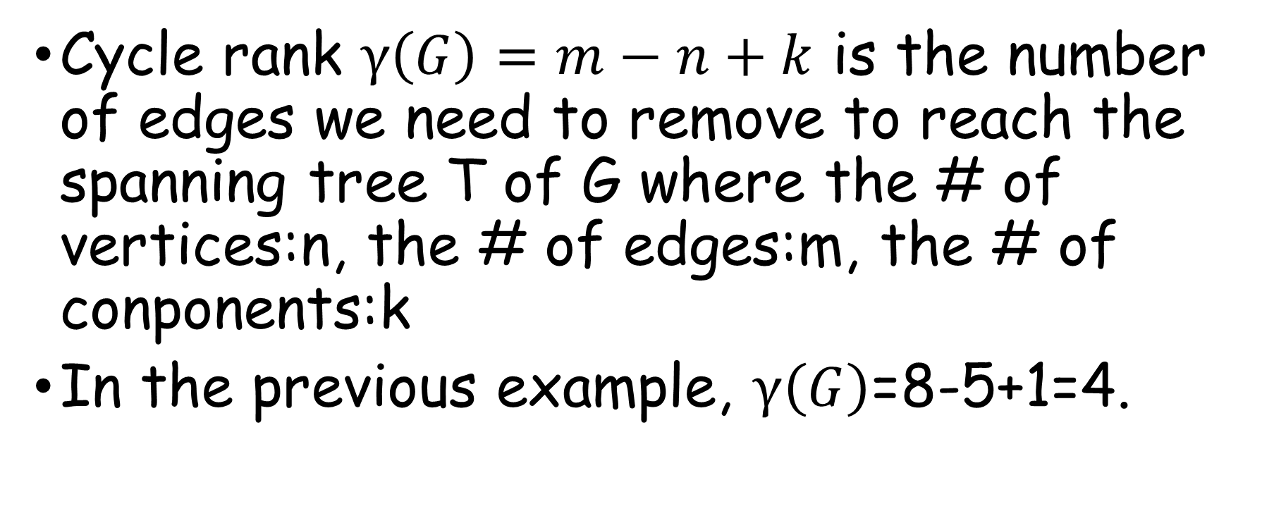
Cycle Rank
Cycle rank $γ\left(G\right)=m−n+k$ is the number of edges we need to remove to reach the spanning tree T of G where the # of vertices:n, the # of edges:m, the # of conponents:k
In the previous example, $γ\left(G\right)$=8-5+1=4.

Slide 9
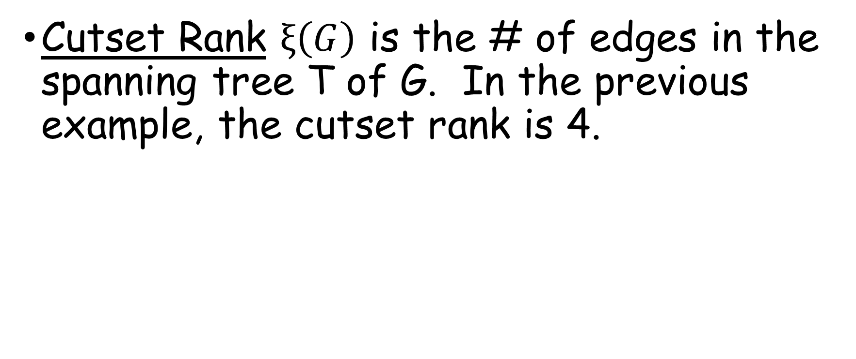
Cutset Rank
Cutset Rank $ξ\left(G\right)$ is the # of edges in the spanning tree T of G. In the previous example, the cutset rank is 4.

Slide 10
Fundamental Set of Cycles of G
These cycles are found by adding exactly one edge that exists in G but not in T.

Slide 11
Example-1
Draw all the spanning trees of the labeled graph below.

Slide 12
Example
Draw the non-isomorphic unlabeled spanning trees with n=6.

Slide 13




Center Vertex
A Center Vertex has the least maximum distance to all other vertices.

Slide 14



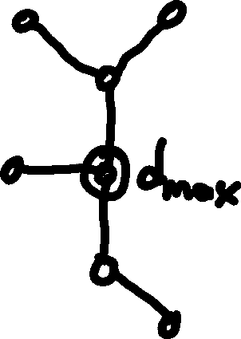
A tree has either one or two
adjacent centers.

Slide 15
Graph Enumeration Problem
How many graphs with a given property can be drawn with a given number of vertices?
The problem was first discussed by Arthur Cayley in 1850s.

Slide 16
Some graph enumeration results

Slide 17
# of labeled non-isomorphic trees
How many labeled non-isomorphic trees with n vertices can be drawn?
Let’s examine the case of n=4.

Slide 18





non-isomorphic
isomorphic
All reverse placements are isomorphic.
We have 4! Possible placements, so
4!/2=12 non-isomorphic trees.
We can only change the center,
other placements are isomorphic.
Only 4 possibilities.
12+4=16

Slide 19
Cayley’s Theorem (1889)
There are n^{n-2} distinct labeled spanning trees on n vertices.
For n=4, there are 4²=16 distinct labeled spanning trees are possible as we found in the previous example.
If we have a complete graph K_{n} we can construct all n^{n-2} spanning trees.

Slide 20
Matrix-Tree Theorem
A connected simple graph G cof(m_{ij}) labeled distinct spanning trees for matrix M.
For non-diagonal elements m_{ij}=-1 if v_{i} is adjacent to v_{j} and 0 otherwise.
For diagonal elements m_{ii}=deg(v_{i}).

Slide 21
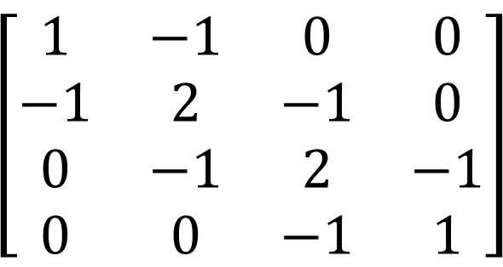
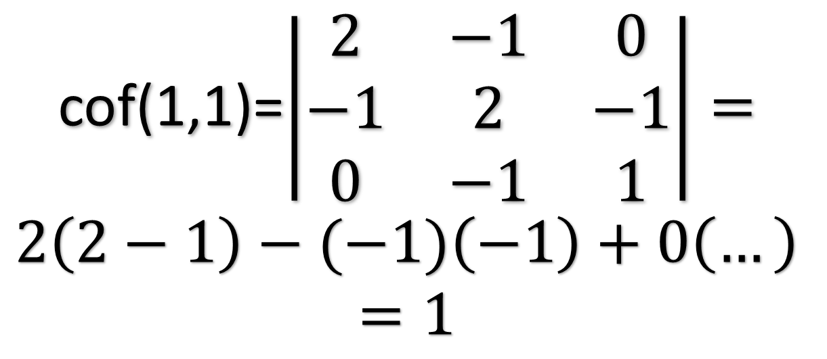
Example-1a
$$\left[\begin{matrix}1 & −1 & 0 & 0 \\ −1 & 2 & −1 & 0 \\ 0 & −1 & 2 & −1 \\ 0 & 0 & −1 & 1\end{matrix}\right]$$
Labeled, incomplete graph
cof(1,1)=$\left|\begin{matrix}2 & −1 & 0 \\ −1 & 2 & −1 \\ 0 & −1 & 1\end{matrix}\right|=$
$$2\left(2−1\right)−(−1)\left(−1\right)+0\left(…\right)$$
$$=1$$

Slide 22

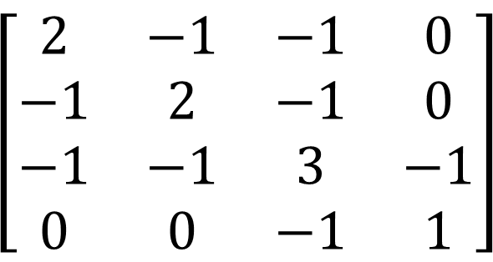




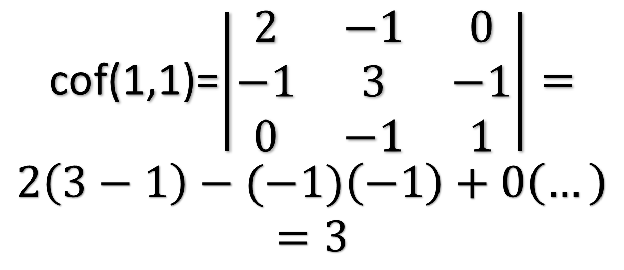

Example-1b
$$\left[\begin{matrix}2 & −1 & −1 & 0 \\ −1 & 2 & −1 & 0 \\ −1 & −1 & 3 & −1 \\ 0 & 0 & −1 & 1\end{matrix}\right]$$
Labeled, incomplete graph
cof(1,1)=$\left|\begin{matrix}2 & −1 & 0 \\ −1 & 3 & −1 \\ 0 & −1 & 1\end{matrix}\right|=$
$$2\left(3−1\right)−(−1)\left(−1\right)+0\left(…\right)$$
$$=3$$

Slide 23
















Example-2(labeled,complete)
For K₃:
3³⁻²=3 distinct labeled spanning trees:

Slide 24
Example-3
How many distinct labeled spanning trees for n=4?
Solved in class, answer: 16.

Slide 25
Let’s take a break.
CME4422

Slide 26
The Minimum Connector Problem
Suppose we wish to build a railway network. We should connect n cities. Distances between cities are weights.
We want to be able to travel from any city to any other city with minimum amount of railway building.
The problem is to find the least possible total weight min(W(T)).

Slide 27
A Greedy Algorithm
Start with the edge of minimum weight. Then choose other edges with minimum weight provided that no cycle is created.

Slide 28




Example

Slide 29
Chemistry
We can build molecules from Carbon and Hydrogen. Carbon atoms can connect to 4 other atoms, but Hydrogen atoms can connect to only one atom.
The family of molecules with the formula C_{n}H_{2n+2} are called alkanes or paraffins.
These molecules may be represented by trees with Carbon atoms as the vertices.

Slide 30
C_{n}H_{2n+2}
3n+2 vertices
3n+1 edges

Slide 31

Electrical networks
To solve for the 8 currents i₀ to i₇
we need 8 linearly independent
equations.
If we choose the following:
VYXV, VWYV and VWYXV
(i₁R₁+i₂R₂=E),(i₃R₃+i₄R₄-i₂R₂=0),
(i₁R₁+i₃R₃+i₄R₄=E)
it doesn’t help us because the equation
obtained from the last loop is just
the sum of equations obtained from the
first two loops.

Slide 32
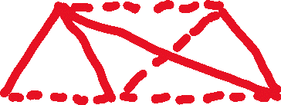


Linearly independent equations can be derived from the loops in the fundamental set of cycles.

Slide 33
Search Trees
Breadth-First
Depth-First

Slide 34












Breadth First

Slide 35












Depth First

Slide 36
The End of Week 8

